Slide 1

FASHION ITEM CLASSIFICATION
Image Classification using the Fashion MNIST Dataset

Slide 2

Introduction
This presentation dives into the classification
of fashion items using deep learning techniques, specifically leveraging the Fashion MNIST dataset.

Slide 3

01
Dataset Overview

Slide 4
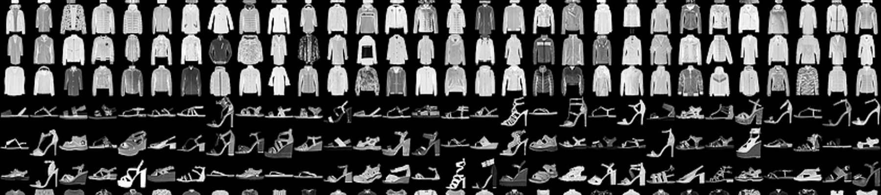
Dataset Source
The Fashion MNIST dataset is sourced from Zalando Research. It serves as a robust benchmark for various image classification tasks.

Slide 5
Dataset
This dataset comprises a total of 70,000 grayscale images, which includes 60,000 images for training and 10,000 images for testing, facilitating effective validation of models.

Slide 6
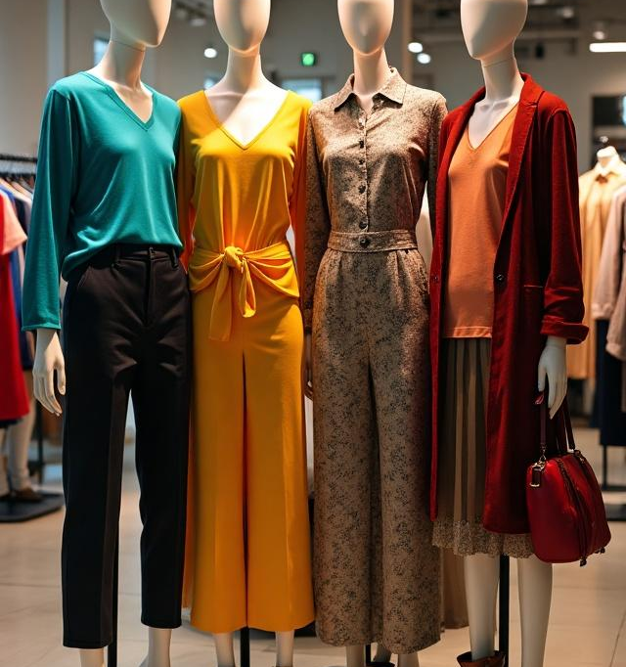
Classes
The Fashion MNIST dataset consists of 10 distinct classes, which include T-shirt/top, Trouser, Pullover, Dress, Coat, Sandal, Shirt, Sneaker, Bag, and Ankle boot. Each class represents a different type of clothing item, enabling the model to learn to differentiate among various fashion categories.

Slide 7

02
Model Architecture

Slide 8

Type of Model
The model utilized for classifying the fashion items is a Convolutional Neural Network (CNN). CNNs are particularly effective for image data due to their ability to capture spatial hierarchies and patterns, making them ideal for this task.

Slide 9
Layers Description
Input Layer: Accepts image data (e.g., 28×28 grayscale images)
Convolutional Layers: Extract features using filters (kernels)
Activation Functions : Introduce non-linearity to the model
Pooling Layers: Reduce spatial dimensions and computation (e.g., MaxPooling)
Dropout Layer: Prevents overfitting by randomly deactivating neurons during training
Fully Connected (Dense) Layers: Learn complex patterns for classification
Output Layer (Softmax): Produces probabilities for each class label (10 fashion categories)

Slide 10

Tools Used
The model is built using the TensorFlow and Keras frameworks, which provide comprehensive tools for constructing, training, and evaluating deep learning models. These libraries support streamlined model development and include built-in functions for loss calculations, optimizers, and metric evaluations.

Slide 11
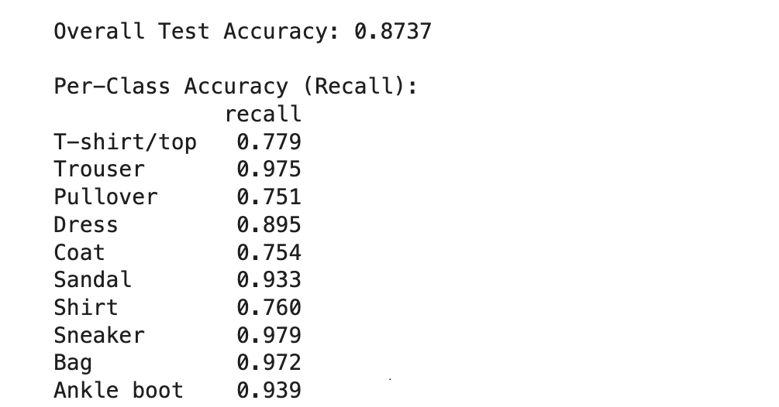
Output

Slide 12
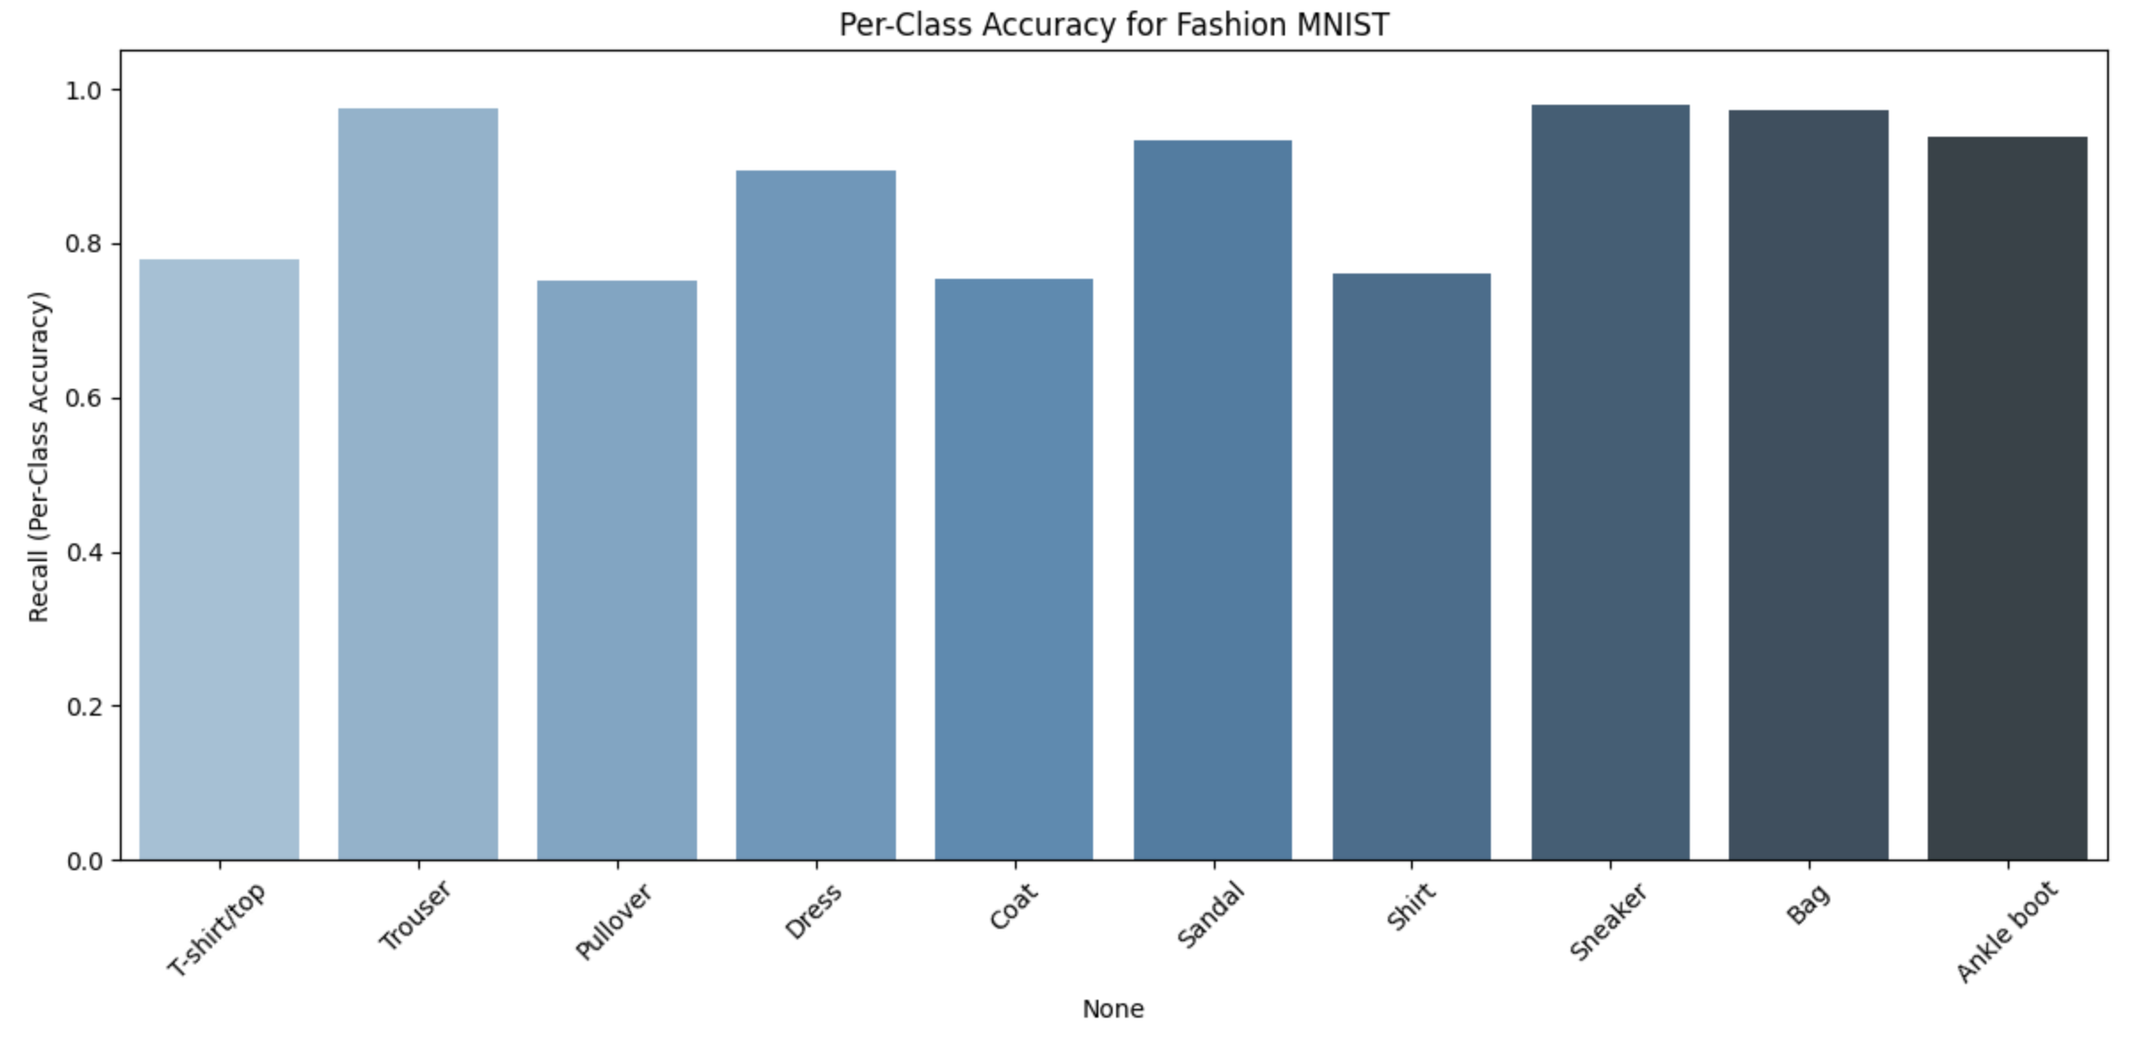
Results

Slide 13
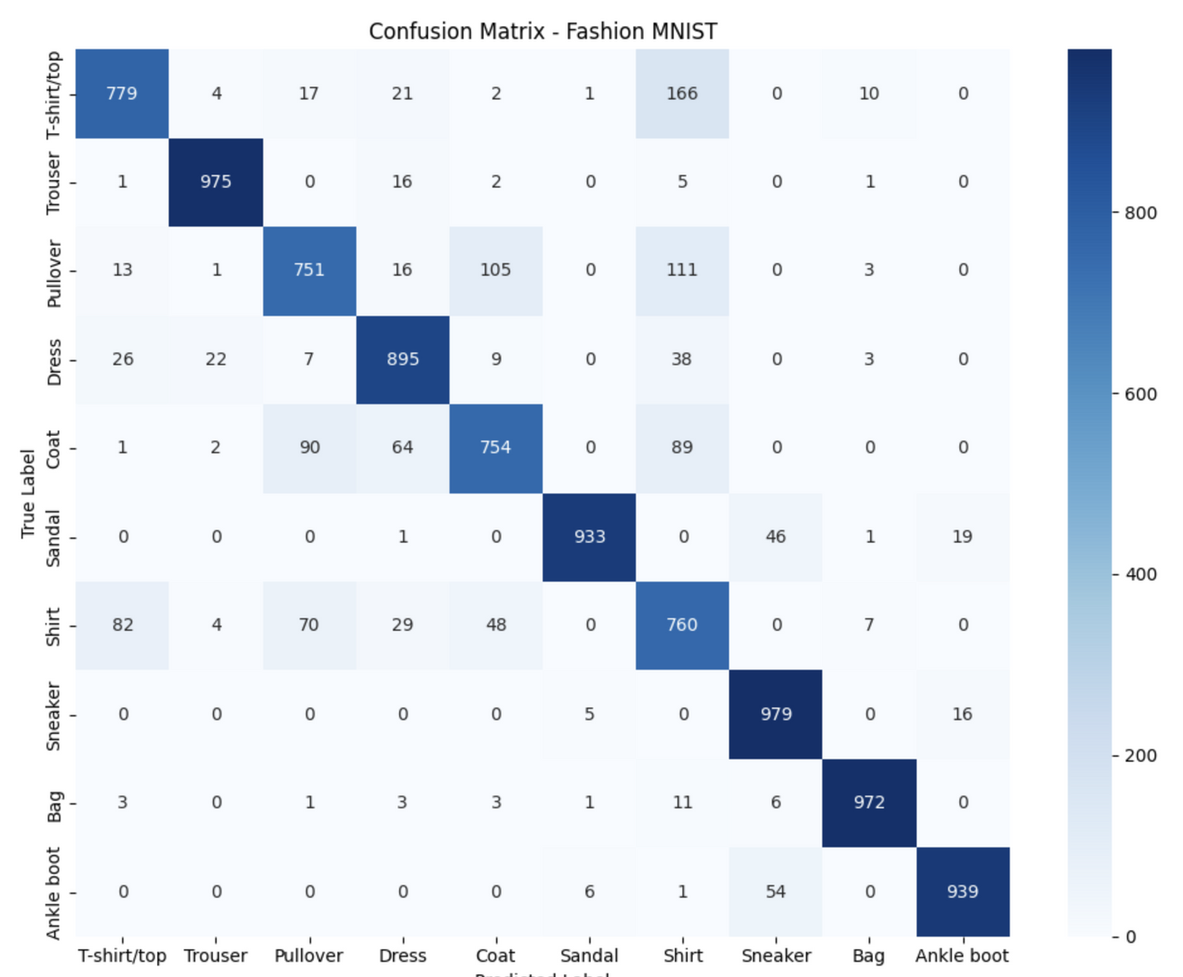
Results

Slide 14
Conclusion
The Fashion MNIST dataset serves as an excellent resource for developing and testing image classification models.
By employing CNNs, the model effectively differentiates between various fashion items.
Future enhancements could include experimenting with more complex architectures and data augmentation techniques to further improve classification accuracy.

Slide 15
Do you have any questions?
Thank you!

